Slide 1
Why We Need to Support Chief Justice Maria Lourdes Sereno

Slide 2
“… and if you swear, 'As the LORD lives,’ in truth, in justice, and in righteousness, then nations shall bless themselves in him, and in him shall they glory."
- Jeremiah 4:2

Slide 3
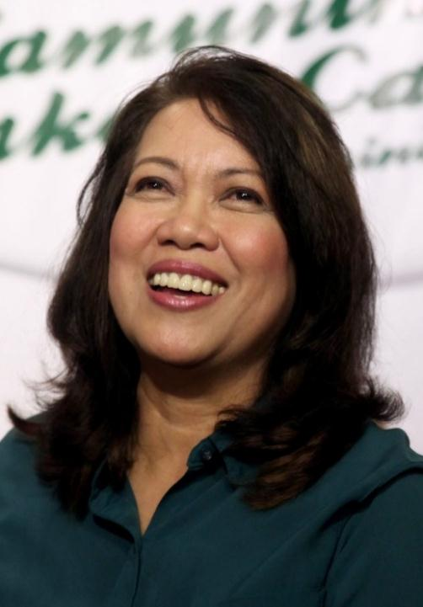
Meilou Aranal Sereno
“Batang Kamuning”
Raised by modest parents
Father was ‘promdi’ from Siasi, Sulu
Mother was a public school teacher
A follower of Jesus since age 12
Member of Higher Rock Christian Church of Pastor Bob Amigo
A deeply committed Christian
PRESENT DAY DANIEL / QUEEN ESTHER

Slide 4
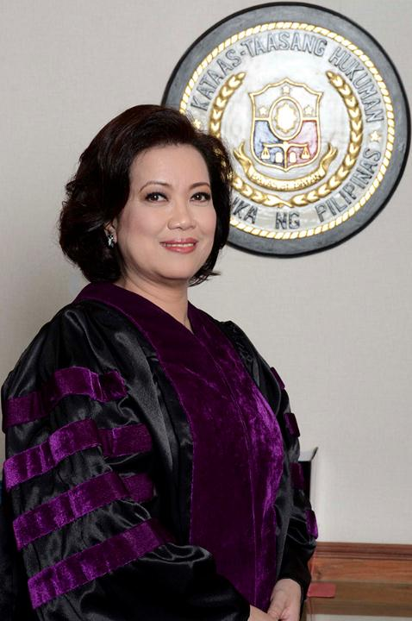
CJ Maria Lourdes Sereno
“She is God’s answer to our prayers for genuine Christians to serve in government. She is the highest ranking Christian government official”
Valedictorian UP Law Class (1984)
Master of Laws, Univ. of Michigan Law School (1993)
Faculty, UP College of Law (1986-2006)
Counsellor, World Trade Organization (1998)
TOWNS National Award (1998)
Associate Justice, SC (2010)
Chief Justice of the Supreme Court (2012)

Slide 5
Groups supporting CJ Sereno
Church Groups
Philippine Council of Evangelical Churches (PCEC)
Intercessors for the Philippines (IFP)
Metro Manila for Jesus Movement (MMJM)
National Council of Churches in the Philippines
Sangguniang Laiko ng Pilipinas (LAIKO – Catholic Church)
Evangelical Free Church of the Philippines (Luzon Region)
NFS Ministry Foundation
Communion of Christian Ministries (CCM)
Law Groups
Integrated Bar of the Philippines (IBP)
Philippine Associate of Law Schools
National Union of People’s Lawyers (NUPL)
Lex Athenia Victoria (women lawyers)
International Pro-Bono Alliance
UP Law Student Government
Ateneo Law School Student Council
Adamson University College of Law

Slide 6
Groups supporting CJ Sereno
Civil Society Groups
World March of Women - Pilipinas
Pwersa ng Pamayanan para sa Voluntarismo at Reporma (PPVR)
Filipinos for Accountability, Integrity, Truth and Honor (FAITH)
Coalition Against Darkness and Dictatorship (CADD)
Martial Law Chronicles Project
Lingap Bilanggo
Mindanao People’s Peace Movement
Manindigan Na
Other Groups
Ateneo De Manila University
Makati Business Club (MBC)
Former Senior Government Officials (FSGO)
International Center for Innovation, Transformation and Excellence in Governance (INCITEGov)

Slide 7
ADMU Statement
"We stand behind these constitutional bodies in their mission to pursue and attain transparency, accountability, truth, and justice,"
"We call on everyone in the community to defend our democratic institutions. Let us urge our leaders in government to allow full independence for these constitutional bodies to implement their crucial mandates by desisting from any form of intimidation in the guise of legal action.
Fr. Jose Ramon Villarin Ateneo De Manila University President Statement in Support of Philippine Constitutional Bodies (Oct. 13, 2017)

Slide 8
IBP Statement
“May we express the hope that impeachment as a process is not being brandished as a weapon of submission, thereby defeating Constitutional design that the judicial branch be insulated from considerations other than the facts and the law in discharging its function of adjudication”
Atty. Abdiel Dan Elijah S. Fajardo National President Integrated Bar of the Philippines (IBP)
Statement issued September 6, 2017

Slide 9
PCEC Supports CJ Sereno
“In this crucial time, wherein her impeachment endangers the foundations of our nation’s democratic institutions, PCEC calls on President Rodrigo Roa Duterte to recognize Chief Justice Sereno as a valuable ally in his fight against all forms of corruption and injustice. We call on our lawmakers to see her as a staunch co-protector of the Constitution and a virtuous co-partner in policy making. We call on members of the judicial branch to stand firmly with her in advancing the Rule of Law.
“We call on all men and women of goodwill to pray for truth and justice to prevail in the impeachment proceedings, and with Chief Justice Sereno, to be vigilant in guarding peacefully our nation’s democracy and civil liberties.”
Bishop Noel Alba Pantoja National Director, Philippine Council of Evangelical Churches PCEC’s statement affirming its support of CJ Sereno (Sept 9, 2017)

Slide 10
Palawan 5 Statement of Support for Chief Justice Sereno
The Book of Proverbs in the Sacred Scriptures teaches us … that “one whose way is straight is an abomination to the wicked” (Pro 29:27) At the first hearing of the House Committee on Justice we witnessed this, as its members denied Chief Justice Sereno her most basic rights, while her accuser was accorded every concession imaginable to present a poorly conceived case built on hearsay and misrepresentations of fact and law.
We believe that the persistent efforts of a powerful few to impeach the Chief Justice on charges that are clearly baseless and malicious are a brazen attempt to silence a jurist who has consistently handed down decisions that are pro-people and pro-Constitution.
2

Slide 11
Palawan 5 Statement of Support for Chief Justice Sereno
If this administration does not recognize the basic rights of the Chief Justice of the Philippines, how do we expect it to respect the basic rights of any Filipino?
We thus call on the Body of Christ in the Philippines to stand up for what is right and oppose this patent injustice. We call on our fellow citizens to stand with Chief Justice Sereno in the face of this partisan attack on judicial independence. We ask our people to echo her call to come to the defense of the Rule of Law.
Bp. NOEL PANTOJA (PCEC) / Bp. DAN BALAIS (IFP) / Bp. LEO ALCONGA (FMCP) / Bro. WYDEN KING (NFS Ministry)
5

Slide 12
Let us PRAY for CJ Sereno
Pray that the lies and baseless accusations against CJ Sereno be exposed
Pray that the House Committee on Justice observe due process; that it be fair as it deliberates on the impeachment complaint
Pray that the members of House Representatives decide on the impeachment complaint based on what is true and what is just
Should the impeachment case reach the Senate, pray that the Senators will judge wisely and fairly
Pray that Chief Justice Sereno be acquitted and vindicated in the end
Pray that the people who conspired to unjustly accuse CJ Sereno receive their due punishment

Slide 13
Let us ACT
Pray for CJ everyday during House impeachment proceedings
Sign the PALAWAN 5 Statement of Support for CJ Sereno
Sign online petitions in support of CJ Sereno
Contact your Congressmen. Write an email, call, visit them at their District Office. Tell them you support CJ Sereno and ask them to do the right thing: observe due process and decide based on truth and justice

Slide 14
"In a time of constant spin, when narratives are coopted to serve the personal agenda of a few, the truth is our bedrock... I have enough faith in the truth to sleep soundly at night; I have enough faith in our people, and in our democratic systems, to know that narratives built on lies will eventually crumble."
- Chief Justice Maria Lourdes Sereno

