Slide 1
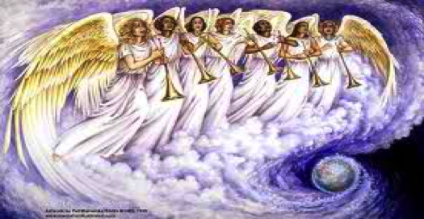
ANGELUS PRAYER FOR CREATION

Slide 2
Leader: The angel of the Lord appeared in a burning bush People: The Lord is King, let the earth rejoice. Hail Mary…

Slide 3
Leader: God looked at everything he had made and found it very good. People: Learn from the way the wild flowers grow. Hail Mary…

Slide 4
Leader: What you do to the least you do to me. People: We await new heavens and new earth. Hail Mary….

Slide 5
Leader: Pray for us Holy Mother of God. People: That we may be made worthy of the promises of Christ.

Slide 6
Let us pray: O God who wonderfully created human nature and still more wonderfully redeemed it, may those you have redeemed understand that there exist nothing more marvelous than the world’s creation at the beginning. Recognizing that all creation is perfected in Christ, may all you have created give you praise and glory now and forever. Glory be….

