Slide 1
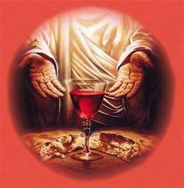
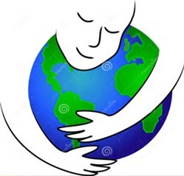
EUCHARISTIC CELEBRATION

Slide 2
Welcome and Introduction

Slide 3
Commentator: Peace and love flowing from the heart of Creation and from the very heart of God, our Loving Creator. We gather today to culminate the Season of Creation and to praise and thank God for the goodness and beauty of creation.

Slide 4
Commentator: Let us, for a moment, be actively silent to open our being to take in all that is around us, to take in Earth, to take in all of life on Earth, to take in the Holy Presence that permeates Earth and the whole of creation... (pause)

Slide 5
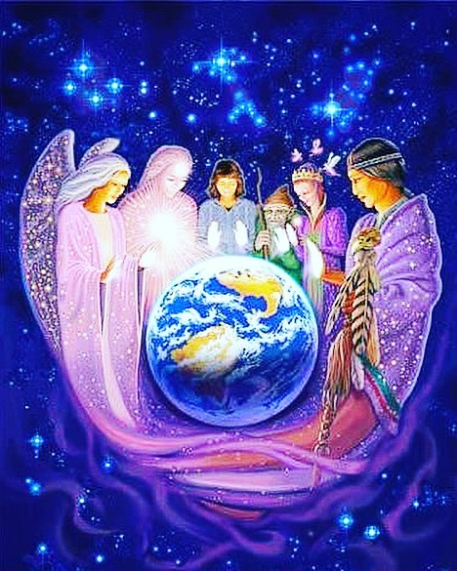
A Prayer of Invocation by Fr. John Leydon and Sr. Elizabeth Carranza

Slide 6
Leader: In Laudato Si, Pope Francis reminds us that “alongside sacred scripture...(nature) is also a continuing revelation of the divine” (cf LS 85). He also reminds us that “The history of our friendship with God is always linked to particular places which take on an intensely personal meaning” (84). We gather now as Filipinos, to whom God has spoken and has revealed the beauty and bounty of creation through special places and creatures in the Philippines.

Slide 7
Leader: We call upon Earth, with its beautiful depths and soaring heights, its vitality and abundance of life, and together ask Her to: Response (all): Come and be with us.

Slide 8
Leader: We call upon the mountains, Mt. Apo and Mt. Dulang-dulang in Mindanao, Mt. Kanlaon in the Visayas, Mt. Pulag and Mt. Mayon in Luzon, the entire Kitanglad, Cordillera and Sierra Madre Ranges, Philippine summits where we encounter deeply the God of peace, and we ask them to: Response (all): Come and be with us.

Slide 9
Leader: We call upon the land which grows our food, the nurturing soil, the fertile fields, the abundant farms, gardens and orchards, and we ask them to: Response (all): Come and be with us.

Slide 10
Leader: We call upon the forests, the great trees reaching strongly to the sky with the Earth in their roots and the heavens in their branches, and we ask them to: Response (all): Come and be with us.

Slide 11
Leader: We call upon the creatures of the fields, mountains, forests and seas, our brothers and sisters Mouse Deer and Tarsier, Philippine Eagle and Golden-Crowned Flying Fox, Giant Mantra Ray and Whale Shark, Saltwater Crocodile and Leatherback Turtle, all creatures who share with us the Philippine bioregions, and we ask them to: Response (all): Come and be with us.

Slide 12
Leader: We call upon those who have lived on this Earth, our ancestors and our friends, all those who dreamed the best for future generations, and upon whose lives our lives are built, and with thanksgiving we call upon them to: Response (all): Come and be with us.

Slide 13
Leader: And above all, we call upon the One whom we hold most sacred, the Triune Lord, wondrous community of infinite love, (LS 246: A Christian Prayer in Union with Creation) the Holy Presence of our Parent God, Source of all beings, the Holy Presence of Jesus, Eternal Word and Love-Incarnate, and the Holy Presence of the Great Spirit flowing throughout the entire Universe and now wanting to rise in our midst to: Response (all): Come and be with us.

Slide 14
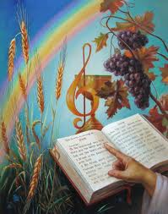
Processional and Gathering Song

Slide 15
Leader: We now acknowledge and honor the presence of one another; the presence of our ancestors; the presence of all of creation and the Very Presence of God in us, among us and around us. Let us with one heart and one voice sing our praise and proclamation of the glory of God.

Slide 16
Magpuri Kayo sa Panginoon Koro: Magpuri kayo sa Panginoong Diyos lahat ng santinakpan Magsiawit kayo at Sya’y ipagdangal magpakailanman

Slide 17
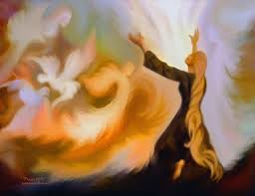
Magpuri kayo mga anghel ng Diyos sa Panginoong Maykapal Magpuri kayo mga langit sa Diyos na sa’nyo’y lumikha. Koro: Magpuri kayo sa Panginoong Diyos lahat ng santinakpan Magsiawit kayo at Sya’y ipagdangal magpakailanman

Slide 18
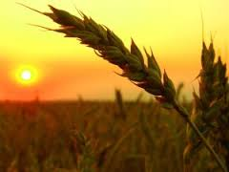
Magpuri kayo sa Panginoon buwan at araw at bituin Magpuri sa Kanyang karangalan ulan at hamog at hangin. Koro: Magpuri kayo sa Panginoong Diyos lahat ng santinakpan Magsiawit kayo at Sya’y ipagdangal magpakailanman

Slide 19
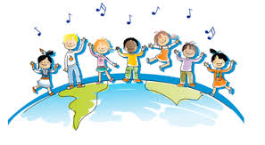
Tanang mga tao sa buong mundo, banal at mabababang puso Purihin ninyo ang Panginoon, sa sala tayo’y hinango. Koro: Magpuri kayo sa Panginoong Diyos lahat ng santinakpan Magsiawit kayo at Sya’y ipagdangal magpakailanman

Slide 20
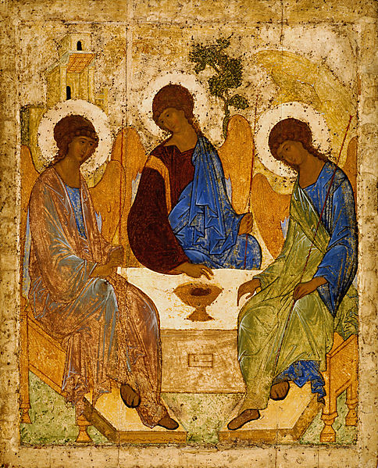
Presider: Good morning sisters and brothers. Let us now begin our celebration in the name of our Loving God, the Father, the Son and the Holy Spirit.

Slide 21
All: Amen

Slide 22
Presider: We are gathered today to celebrate the glory of God alive in all creation and in particular to culminate our celebration of the Season of Creation. Let us especially offer this celebration for the healing of the wounds that we humans have caused our Nurturing Mother Earth.

Slide 23
In the beginning, God, our Loving Creator brought forth the Universe in all its splendor and beauty. Despite our lack of care and sense of responsibility, God continues to nourish us through the gifts of creation.

Slide 24
Yet, as God continues to bless us with the gifts of creation, God also continues to remind us of being brothers and sisters, carers and stewards of all life on earth.

Slide 25
Let us pray to this Loving and Generous God to unite all of us in this beautiful celebration of the Holy Eucharist. Let us pray that as One Body of Christ, together with all of creation,

Slide 26
we may sing the glory and praise of God’s name and as one people, remember with gratitude all the blessings God has showered and continues to shower upon us through the bounty of creation.

Slide 27
We pray, too, that through our celebration of the World Day of Prayer for the Care of Creation, we may together renew our commitment to care for our Common Home and to bring back the splendor and beauty of the Universe.

Slide 28
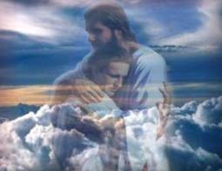
Penitential Rites

Slide 29
Presider: As we celebrate the glory of God in all of creation and renew our commitment today to care for our Common Home,

Slide 30
let us especially implore God’s mercy for those sins we have committed against creation and for not hearing both the cry of the earth and the cry of the poor… Panginoon, Maawa Ka is sung…

Slide 31
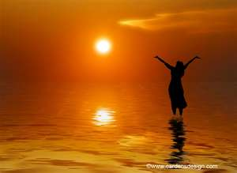
Gloria

Slide 32
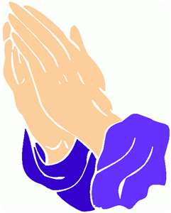
Opening Prayer

Slide 33
Presider: God of Love and Life, let your Creative Spirit flow in us and through us to renew the face of the earth. Make of us channels of nourishment for one another and for all beings on earth

Slide 34
through Jesus Christ your Son who offered Himself to become Living Bread for all who hunger and Living Water for all who thirst, now and forever.

Slide 35
All: Amen

Slide 36
LITURGY OF THE WORD

Slide 37
First Reading Habakuk 1:2-3; 2:2-4

Slide 38
Reader: The Word of the Lord. All: Thanks be to God.

Slide 39
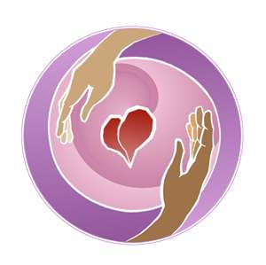
Responsorial Psalm If today you hear his voice, harden not your hearts.

Slide 40
Second Reading 2 Timothy 1:6-8, 13-14

Slide 41
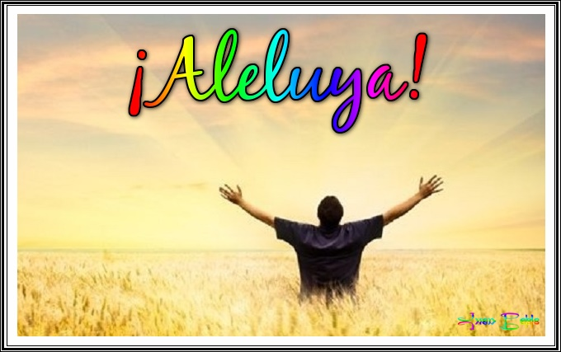
Gospel Acclamation: Aleluya, aleluya, kami ay gawin mong daan ng iyong pag-ibig, kapayapaan at katarungan, aleluya!

Slide 42
Presider: The Lord be with you. All: And also with you.

Slide 43
Presider: The proclamation of the Holy Gospel according to Matthew. All: Glory to you, O God.

Slide 44
Gospel Reading Luke 17:5-10

Slide 45
Presider: The Good News of our salvation. All: Praise to you, Lord, Jesus Christ.

Slide 46
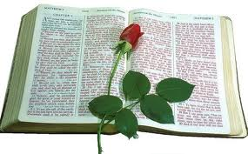
Homily

Slide 47
Profession of Faith

Slide 48
LITURGY OF THE EUCHARIST

Slide 49
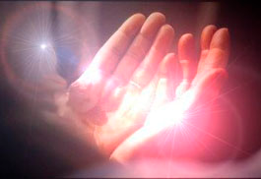
Prayers of the Faithful and Symbolic Offering

Slide 50
Presider: In the presence of our God whose Spirit made us to gather, we have come in awe. In the presence of our God who has sent His Word to live with us, we have come in faith.

Slide 51
In the presence of our God whose arms hold us as children and whose love nourishes us, we have come in trust. In awe, faith and trust,

Slide 52
what do we want to bring now in the Presence of God. For each of the gifts we bring, we echo in one voice: PRAISE BE TO YOU, LORD, GOD OF ALL CREATION!

Slide 53
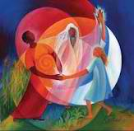
Praise be to you, Lord, God of all creation.

Slide 54
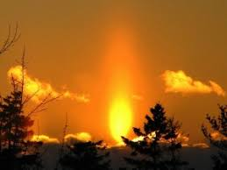
Commentator: We bring to you, in awe, the gift of Fire: the fire from the sun that fuels all life. (Fire is brought in)

Slide 55
Praise be to you, Lord, God of all creation.

Slide 56
Commentator: God of all creation, in faith and trust, we ask you: grace us with the Fire of Your Love that we may hear with compassion both the cry of the Earth and the cry of the poor. (short silence)

Slide 57
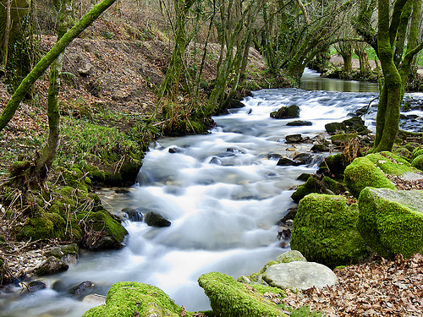
Commentator: We bring to you, in awe, the gift of water:

Slide 58
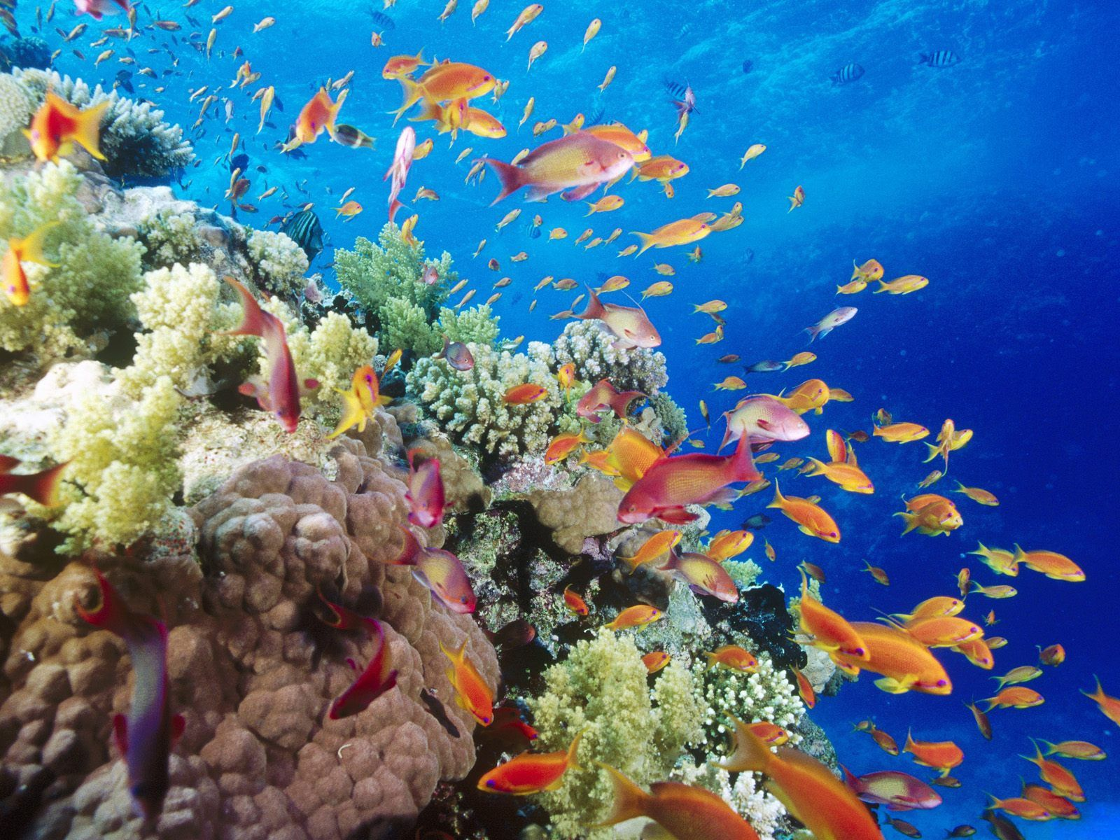
water that flows from your streams and rivers,

Slide 59
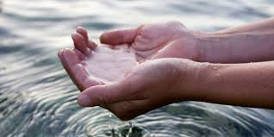
water that quenches our thirst, water that cleanses, and heals. (Water is brought in)

Slide 60
Praise be to you, Lord, God of all creation.

Slide 61
Commentator: God of all creation, in faith and trust, we ask you: let Your Healing Love flow in and among us that we may together bring healing to the wounds of the world. (short silence)

Slide 62
We bring to you, in awe, the gift of air: the gaseous realm, the atmosphere, the planet’s membrane.

Slide 63
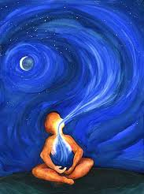
Your Breath of Life. Our inhale and exhale. (Air is brought in)

Slide 64
Praise be to you, Lord, God of all creation.

Slide 65
Commentator: God of all creation, in faith and trust, we ask you: breathe into us Your Power to build together our Common Home. (short silence)

Slide 66
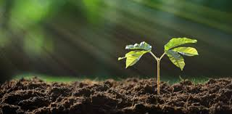
We bring to you, in awe, the gift of Earth: life-giving soil;

Slide 67
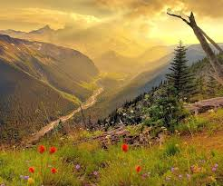
mountains of peace, valleys and gardens of joy. (Earth is brought in)

Slide 68
Praise be to you, Lord, God of all creation.

Slide 69
Commentator: God of all creation, in faith and trust, we ask you: grant unto us the Power to grow and bring forth life, peace and joy in the world. (short silence)

Slide 70
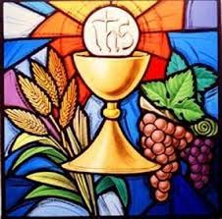
Commentator: We bring to you, in awe, this bread and this wine, fruits of the Earth and works of our hand. (Bread and wine are brought in)

Slide 71
Praise be to you, Lord, God of all creation.

Slide 72
Commentator: God of all creation, in faith and trust, we ask you: transform our humble gifts of bread and wine into the Body and Blood of Your Son Jesus Christ who, in His great love, is bringing us and all of creation to fullness of life. (short silence)

Slide 73
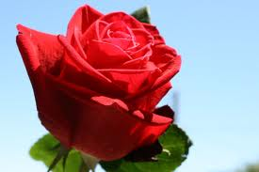
Offertory Song: Kapuri-puri Ka Kapuri-puri ka, Diyos Amang lumikha ng lahat Sa Iyong kagandahang-loob narito ang aming maiaalay

Slide 74
Mula sa lupa at bunga ng aming paggawa Ang tinapay na ito para maging pagkaing nagbibigay-buhay Kapuri-puri ang Poong Maykapal Ngayon at magpakailanman Kapuri-puri ang Poong Maykapal Ngayon at magpakailanman

Slide 75
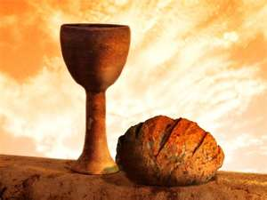
Kapuri-puri ka, Diyos Amang lumikha ng lahat Sa Iyong kagandahang-loob narito ang aming maiaalay

Slide 76
Mula sa ubas at bunga ng aming paggawa Ang alak na ito para maging inuming nagbibigay-lakas Kapuri-puri ang Poong Maykapal Ngayon at magpakailanman Kapuri-puri ang Poong Maykapal Ngayon at magpakailanman

Slide 77
Presider: God of all creation, let the gifts of your Spirit overflow in these gifts of bread and wine that we have offered so that we may be found worthy of your life-giving and all-embracing Love.

Slide 78
We ask this through Jesus Christ, your Love made flesh for the life of the entire cosmos from the beginning and till the end of time and onto life everlasting.

Slide 79
All: Amen

Slide 81
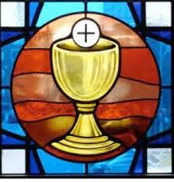
Communion Song

Slide 82
Kahanga-hanga Koro: Kahanga-hanga ang Iyong pangalan, O Panginoon sa sangkalupaan. Ipinagbunyi Mo ang Iyong Kamahalan sa buong kalangitan.

Slide 83
Pinagmamasdan ko ang langit na gawa ng ‘Yong mga kamay. Ang buwan at mga bituin na sa langit ‘Yong inilagay.

Slide 84
Koro: Kahanga-hanga ang Iyong pangalan, O Panginoon sa sangkalupaan. Ipinagbunyi Mo ang Iyong Kamahalan sa buong kalangitan.

Slide 85
O sino kaya siyang tao na Iyong pinagmamasdan? Ginawa Mong anghel ang katulad, pinuno Mo ng karangalan.

Slide 86
Koro: Kahanga-hanga ang Iyong pangalan, O Panginoon sa sangkalupaan. Ipinagbunyi Mo ang Iyong Kamahalan sa buong kalangitan.

Slide 87
Malayo man ang tao sa lupa, sakupin man niya ang buwan. Ikutin man ang kalangitan, ang D’yos rin ang dinadatnan.

Slide 88
Koro: Kahanga-hanga ang Iyong pangalan, O Panginoon sa sangkalupaan. Ipinagbunyi Mo ang Iyong Kamahalan sa buong kalangitan.

Slide 89
Ipinagbubunyi “Yong pangalan ng ibon na lumilipad. Pinahahayag ng kabundukan “Ikaw ang Poon ng lahat!”

Slide 90
Koro: Kahanga-hanga ang Iyong pangalan, O Panginoon sa sangkalupaan. Ipinagbunyi Mo ang Iyong Kamahalan sa buong kalangitan.

Slide 91
Sa dahong hinihipan ng simoy ang tinig Mo’y mapapakinggan. Sa ulan na biyaya ng langit kabutihan Mo’y makakamtan.

Slide 92
Koro: Kahanga-hanga ang Iyong pangalan, O Panginoon sa sangkalupaan. Ipinagbunyi Mo ang Iyong Kamahalan sa buong kalangitan.

Slide 93
Prayer After Commnion

Slide 94
Presider: God of Love and Life, you have nourished your people with the fruits of the Earth. You have transformed these humble gifts into the Body and Blood of your Beloved Son and we have received them as both food and drink for our body and spirit.

Slide 95
Let the power of these gifts remain in us so that the Love of your Spirit may overflow in us and through us. May these gifts we have shared in this celebration grace us to become channels of your Love and Life through Jesus Christ your Son who lives and reigns with you and the Holy Spirit, one God forever and ever.

Slide 96
All: Amen

Slide 97
Concluding Rites

Slide 98
Presider: The Lord be with you. All: And with your spirit. Presider: Bow your heads now as we pray for God’s blessing:

Slide 99
Presider: God of all creation, you were pleased to make Earth your Home and Home for all your created beings. Make us ever aware of and allow us to feel the Breath of Life that unites us to You, to all of humanity and to all of creation.

Slide 100
Guide us with your wisdom and love through your Holy Spirit. Teach us to use science and technology wisely for our good and the good of all our sister and brother beings. Remain with us as we continue to journey with the whole of creation towards the new heaven and the new earth which you have promised us.

Slide 101
Presider: May the peace of the flowing streams and rivers, the peace of the gentle breeze, the peace of the heavenly skies, the peace of the green fields, the peace springing from the heart of our dear Mother Earth be upon us.

Slide 102
Above all, may the peace overflowing from Your Most Sacred Heart, our Loving God, the Father, the Son and the Holy Spirit be with us now and forever.

Slide 103
All: Amen

Slide 104
Presider: Our celebration of the life of Mother Earth and of all creation continues. Let us go forth from here with renewed vigor and sure in our conviction that the God of Life and Love never abandons us, constantly journeys with us, inspires and guides us to find new ways of moving forward together in caring for all of creation.

Slide 105
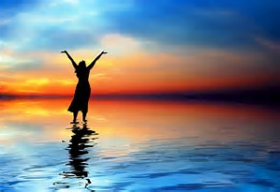
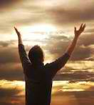
All: Thanks be to God.

Slide 106
Magpasalamat Kayo sa Panginoon Koro: Magpasalamat kayo sa Panginoon Na Syang lumikha ng lahat ng bagay dito sa mundo Siya’y gumawa ng buwan at mga bitwin Upang magbigay ng liwanag sa pagsapit ng dilim

Slide 107
Koro: O magpasalamat sa kanyang mga biyaya at awa O ating purihin ang Poon na mahabagin sa atin

Slide 108
Magpasalamat kayo sa Panginoon Dahil sa kagandahang loob niya’y magpakailanman At pagpalain ang Diyos habang buhay Na siyang nagligtas sa Kanyang hinirang bayang Israel

Slide 109
Koro: O magpasalamat sa kanyang mga biyaya at awa O ating purihin ang Poon na mahabagin sa atin

